Slide 1

NET card Training
Travel Office - 2025

Slide 2
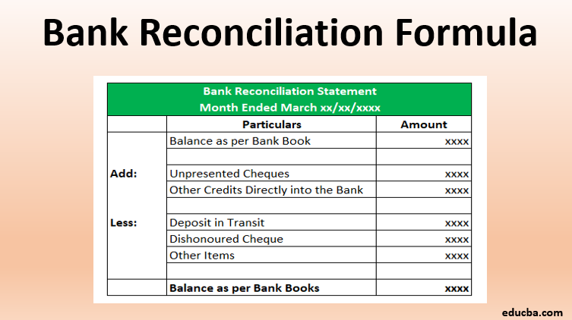
WHAT IS CREDIT CARD RECONCILLIATION?
Credit card reconciliation is the process of verifying and comparing the transactions on a statement and matching them to the travel documents (receipts, invoices, folios, etc.) to ensure accuracy and completeness.

Slide 3

PURPOSE AND GOALS OF RECONCILING
AN AGENCY CARD STATEMENT
To reconcile and approve expenses charged on the card.
To review all charges for accuracy, fraud, and discrepancies.
To confirm that every charge listed on the statement is listed on a Group Travel Reconciliation (GTR), or an Expense Log.
To verify the total charges listed on all travel forms (GTR, Expense Log) matches the total on the credit card statement.

Slide 4
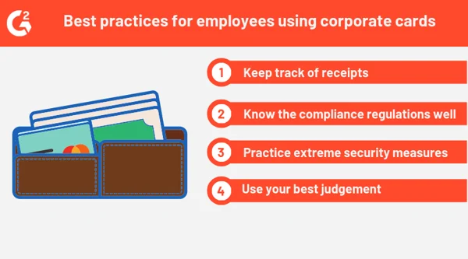
POLICY
Expense reports must be submitted within 30 days of the end of the travel event to reimburse the traveler for out-of-pocket expenses, and to reconcile the associated agency travel card bill.
This allows the agency time to prevent unnecessary interest charges accruing and to reconcile unreported charges, or any unauthorized use that would need to be disputed.
If there are no credit card charges in a month, no documentation is required.

Slide 5
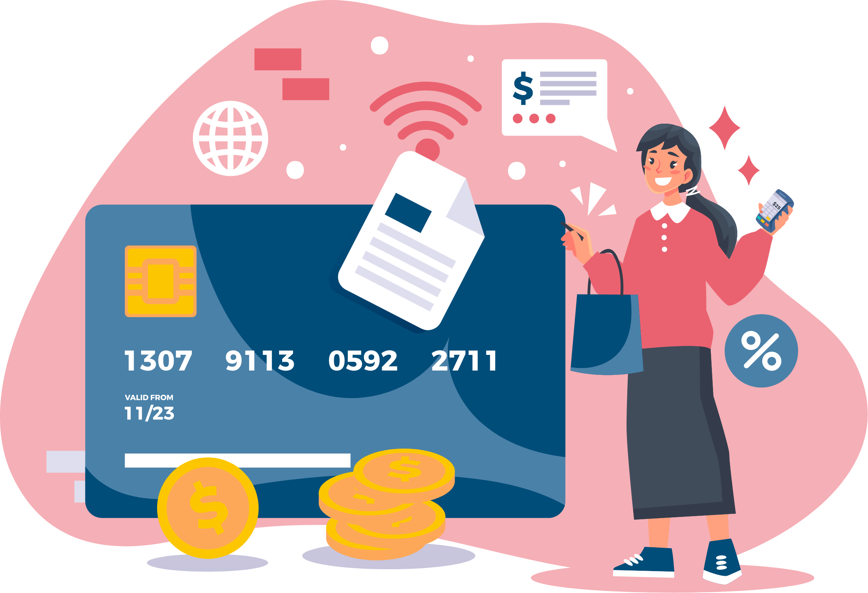
CARD HOLDERS ARE RESPONSIBLE FOR:
    Monitoring the card activity on your monthly statement and through JPMC PaymentNet for incorrect, duplicate, or fraudulent charges
    Disputing incorrect or duplicate charges: First reach out to the vendor for resolution. If you are unable to resolve the problem, contact J.P. Morgan for further assistance using the number on the back of the card.
    All disputes must occur within 60 days of the transaction date.
    Reconciling the statement within 30 days after the statement is available.
    Deduct any unallowable expenses on your travel forms. Ineligible expenses include those for other individuals.
    To be a valid receipt it must show: the name of the vendor, date of the transaction, itemized details, final amount due, and confirmation of payment in full.
    If a receipt is lost, contact the vendor for a replacement if possible. If not available, submit a statement explaining the lost receipt.
    Cardholders in violation of compliance may have card privileges suspended or permanently revoked.

Slide 6

PRE-TRIP INSTRUCTIONS
A travel pre-approval must be completed and approved prior to the first day of business travel.
  You must always obtain Departmental/Account Signatory approval before making a charge on the NET card.

Slide 7
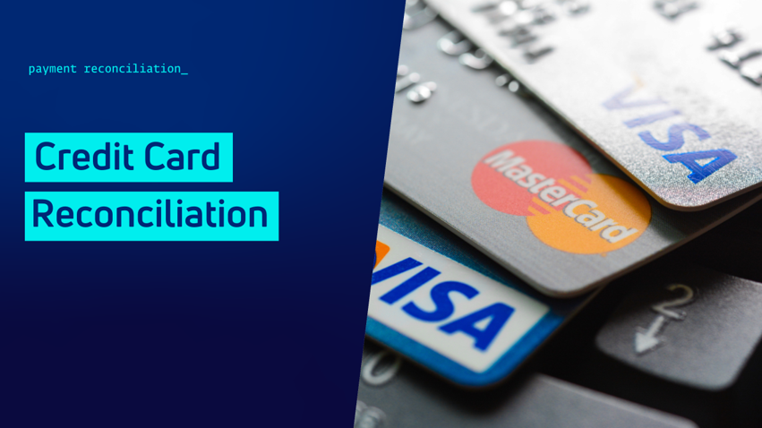
NET CARD RECONCILIATION
Detailed steps on Slides 8 - 10

Slide 8
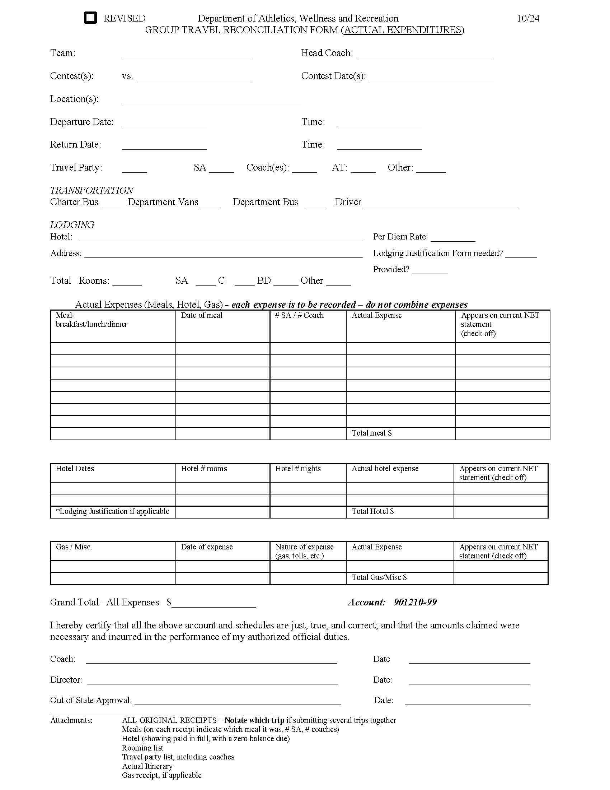
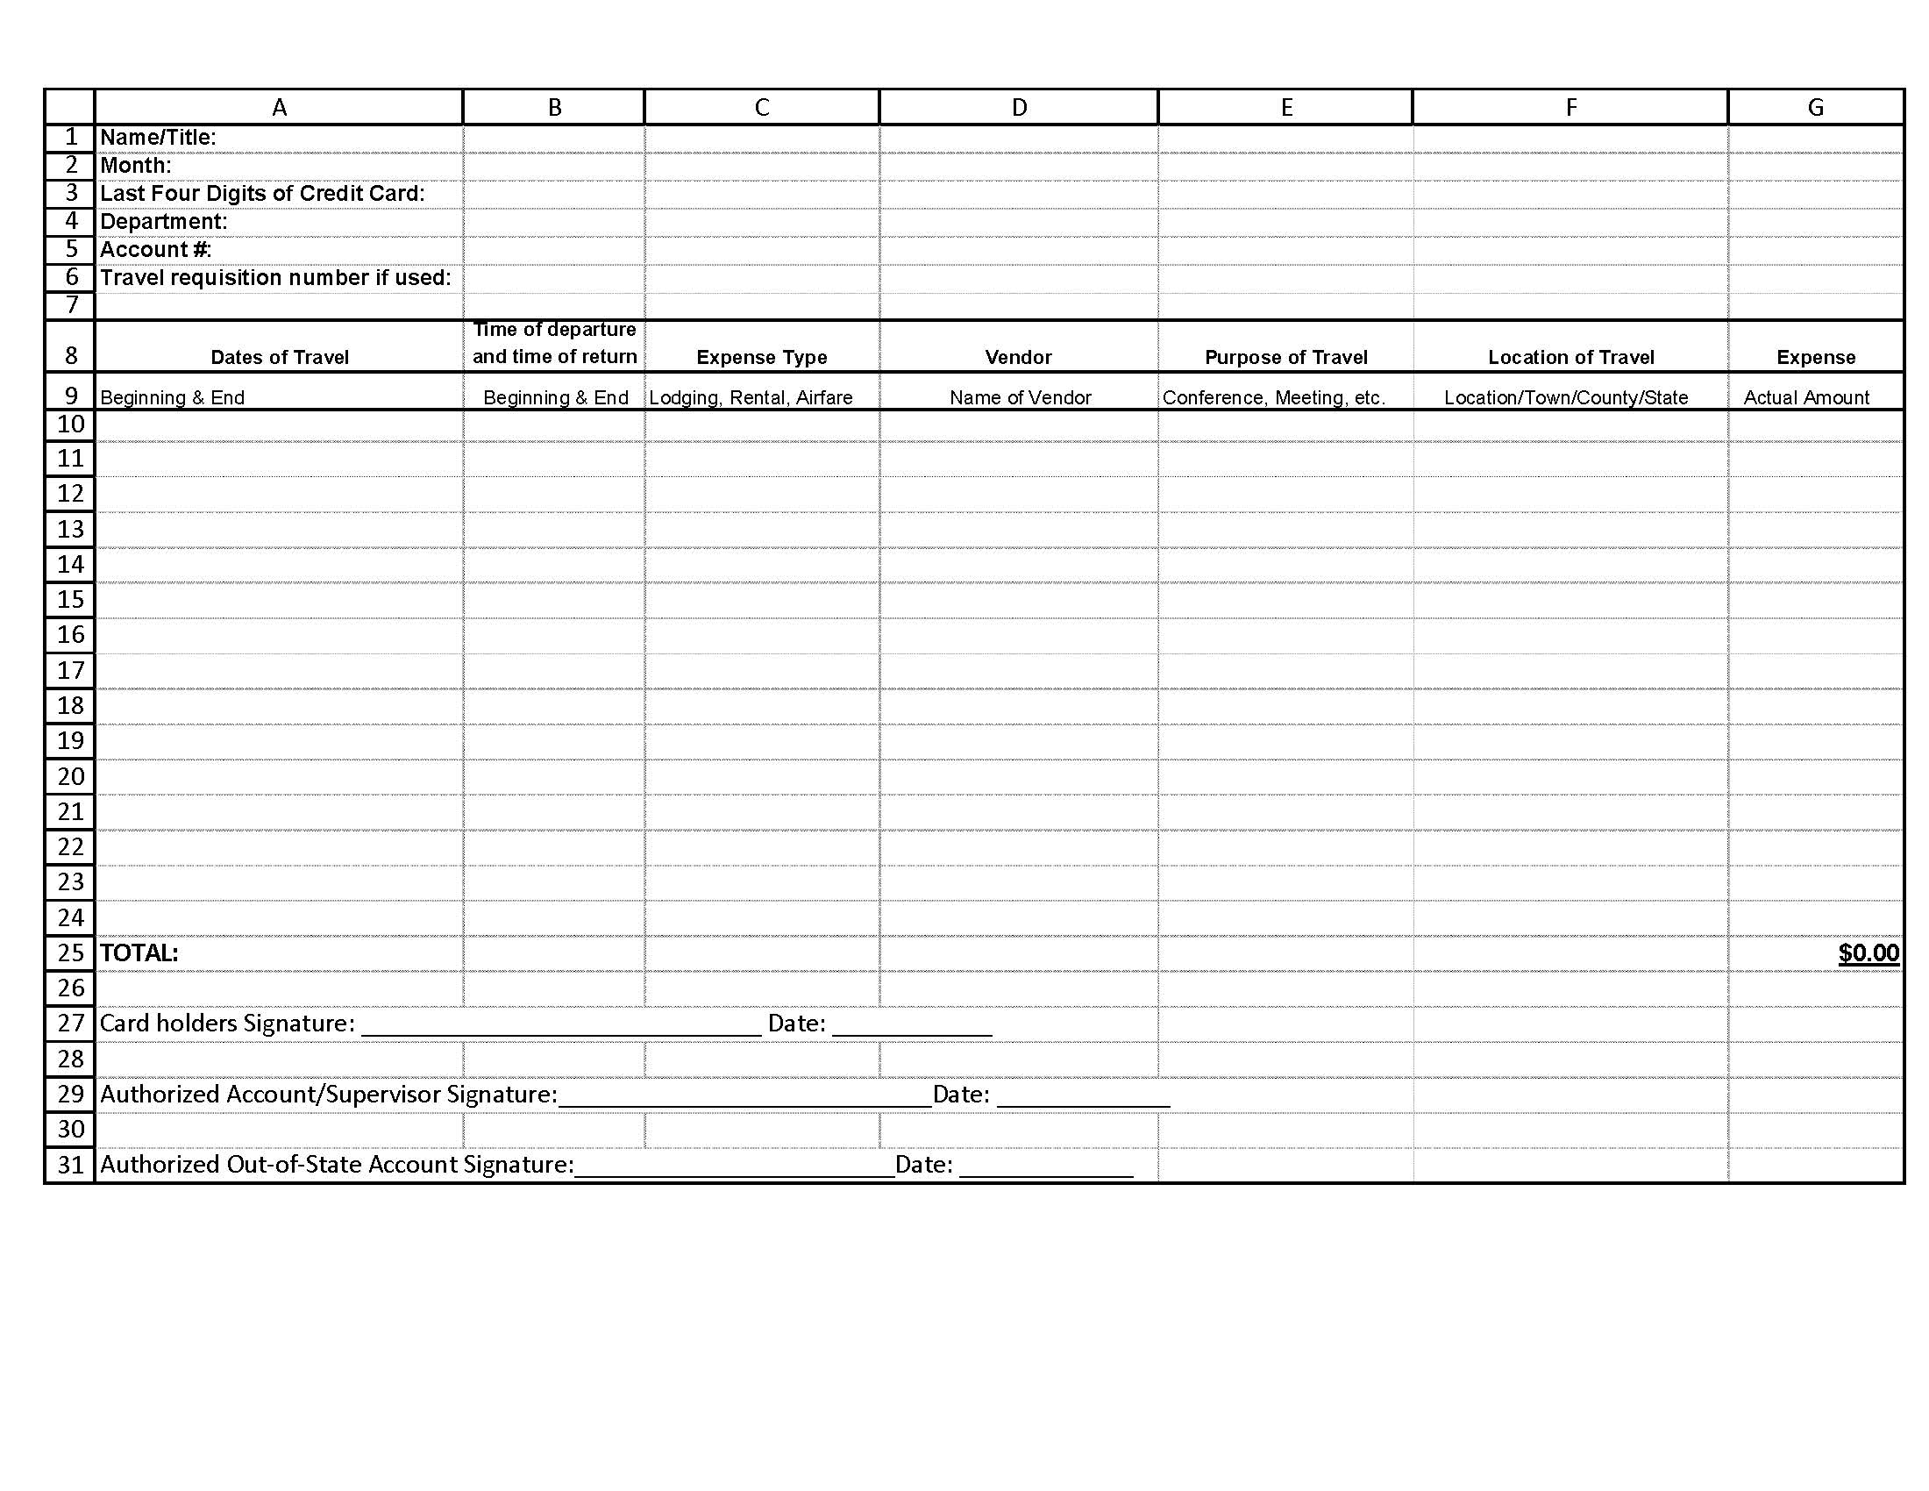
NET CARD RECONCILIATION STEPS
  Logon to JPMC and download the NET Card statement.
  Collect all receipts which are listed on the current statement.
  Identify which trip each receipt belongs to. Notate trip name/place on each receipt ~OR~ name each PDF document using the trip and type of receipt (NJ Meal, Drew Hotel, CA Airfare, etc.). Don’t name the receipt, “Panera”, “ShopRite”, etc.
  Complete the necessary reconciliation document, with the account number and required signatures. List each transaction shown on your NET statement.
    Athletics: Complete a Group Travel Reconciliation Form (GTR) for each trip.
    All others: Complete an Excel Expense Log.

Slide 9
  Submit each Expense Report or GTR separately with the applicable receipts, agenda/itinerary, list of non-employee names, and all additional forms as needed (Auto Statement, Lodging Justification, Detail Sheet).
  If you are submitting several trips in one email, please save each trip as a single PDF (with the Expense Report/GTR, agenda, statement, receipts, and any other documents needed) – OR – name each PDF receipt with the trip name and type of document.
  Note: Always provide an agenda or schedule from the conference or itinerary for the event.
  You are required to submit itemized paid receipts for all expenses listed on the Expense Report/GTR, showing the form of payment.
  Include copies of the full receipt, even if it is multiple pages.
  After all the Expense Reports or GTR’s are completed, add the totals. Verify that all the totals from your forms are equal to the total on your current NET statement.

Slide 10
  A detail sheet may be needed to show the details of a trip with multiple steps or for clarification. This is to explain each part of the trip and corresponding expenses. List the date, time, details, and amount for each item.
  List each expense on a separate line on the GTR (e.g., don’t add 2 meals on one line).
  It may be helpful to check off or highlight each expense on the statement to be sure none are missed.
  Reminder: Check the per diem rates and submit a Lodging Justification form when the hotel rate is higher than the per diem rate. The Provost or divisional Vice President must sign this form.
  Submit your Expense Report or GTR(s) and all documentation in electronic format to: travel@newpaltz.edu.
  Please do not respond to the email we send monthly when the statement is available. Send a separate email.

Slide 11

FOREIGN TRAVEL
The traveler is responsible for becoming familiar with current international travel rules/regulations. travel.state.gov is a good resource.
Travel outside the United States is reimbursed based on the maximum per diem allowance established by the US Department of State.
All receipts/documents in a foreign language must be translated.
All currency must be converted. Include a screenshot of the OANDA website for each expense to show the conversion rate on the date of the purchase. Don’t use the date you obtain the conversion as the date.
If the credit card statement includes the conversion to USD, you don’t need to provide the conversion sheet.
Important: Beginning mid 2025, some European countries will have new entry requirements.
  Travelers will need to apply in advance for authorization through a visa process known as the EU Travel Information & Authorization System (ETIAS). You can find details on the EU travel website.

Slide 12

NET Card Rules
Agency JPMC VISA Cards are issued to the individual traveler and are for travel expenses only.
Before charging any travel transactions on your card, check your account(s) to make sure you have the funding available to support your purchase and have all the necessary approvals.
Check your online account before every trip to be sure your transaction limits will cover the cost of the trip.
  If you need the limits increased, ask the account signatory to send us an email listing the limits needed (single transaction and monthly transaction), as well as stating if it is a permanent increase or just for this trip.
  We will also increase your card limits when our office receives an approved Travel Requisition, along with a note letting us know an increase is needed.
  Let us know if your card limits should be decreased for security purposes after a large trip.
An email is sent each month when the statements are available.
To apply for a Travel or NET card:
  Speak to your Supervisor to see if this is recommended for you.
  Email (grayt@newpaltz.edu) directly to request an application.

Slide 13

NET Card Exclusions
Prohibited Purchases:
  Personal purchase of any kind. If you have a business/personal mixed trip, do not use the agency card.
  Alcoholic beverages.
  Purchases not within travel guidelines.
  Incidentals on hotel bills (gym/spa charges or movie rentals).
  Gas for a personal vehicle. Gas is included in the mileage rate.
  Expenses for College Foundation, Research Foundation, or CAS trips.
If a State employee uses the card for personal or fraudulent use, the employee will be personally liable for those personal or fraudulent expenses improperly charged to the card.

Slide 14

Questions?
newpaltz.edu/travel
travel@newpaltz.edu

